Slide 1

Microsoft Excel
LECTURE 6

Slide 2
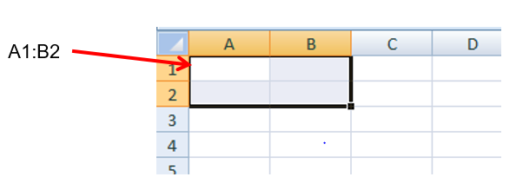
Cell Range
A rectangular box of cells is called a “range”.
The name of a range is
  the name of the upper left cell of the range
  Followed by a colon :
  Followed by the lower right cell of the range
Example: A1:B2 is shorthand for A1,A2,B1,B2

Slide 3
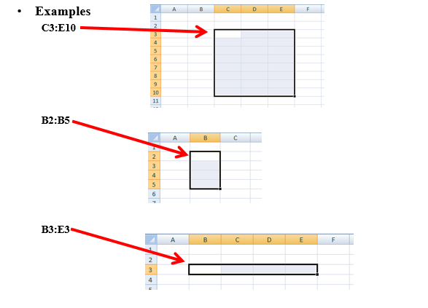
Examples of Range Names
A
B
C

Slide 4
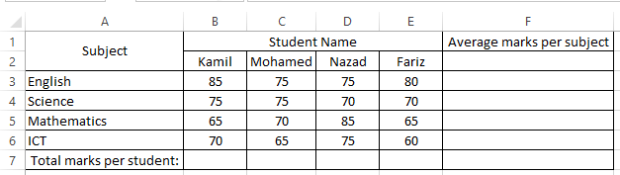
Activity 1 –
Write the suitable formula to calculate the following....

Slide 5
Formulas
You must have an equal's sign ( = ) as the first character in a cell that contains a formula.
The = sign tells excel that the contents of the cell is a formula.
Without the = sign, the formula will not calculate anything. It will simply display the text of the formula.

Slide 6
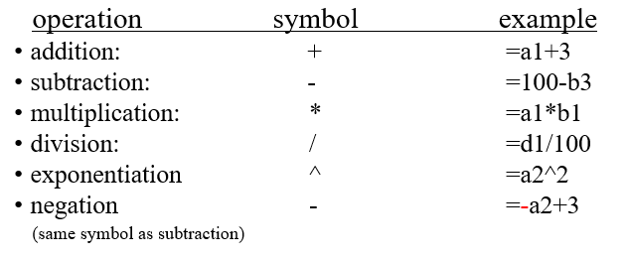
Types of operations
You can use any of the following operations in a formula:

Slide 7
Order of Operations- Complex formulas
You can use several operations in one function
You can group those operations with parentheses
Examples
  =3*2+1
  =c1*(a1+b1)
  =(100*a2-10)+(200*b3-20)+30
  =(3+2*(50/b3+3)/7)*(3+b7)

Slide 8
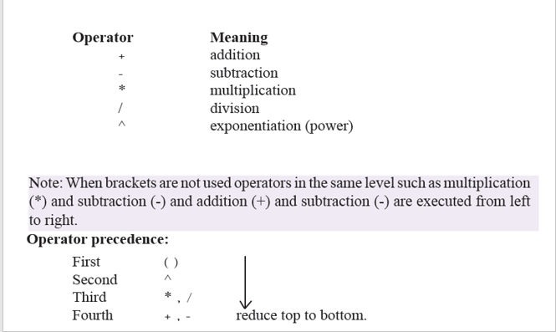
Order of operations
Note:
When brackets are not used operators in the same level are executed from left to right.

Slide 9
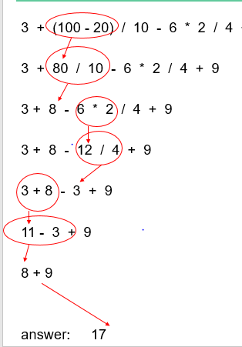
Order of operations
The value of 3 + 2 * 5
is 13 and NOT 25

Slide 10
Activity 2 -
Evaluate the following equations
= 6-4/2+6
= 4-5*2^3
= 3*(2+4)/9-1

Slide 11
Explicit (literal) values and cell references
You can use both explicit values and cell references in a formula.
An explicit value is also called a literal value.
  Formula with only cell references: =a1*b1
  Formula with only literal values: =100/27
  Formula with both cell references and literal values: =a1/100

Slide 12
What is a function?
A function is a "named operation"
Functions have
  a name
  parentheses
  parameters/arguments inside the parentheses
    The words parameter and argument mean the same thing
    you can have many parameters for one function separated with commas (,)
    The number of parameters is one more than the number of commas.

Slide 13
Terminology
=SUM(1,2,3,4,5)
  The name of the function is "SUM"
  The parameters or arguments to this function are 1,2,3,4 and 5
  The entire thing, i.e. SUM(1,2,3,4,5), is a function call
  The value of this function call is 15.
  Another way to say this is that this function call returns 15.

Slide 14
Using a range as a parameter
Ranges can be specified as a parameters to a function call.
Both of the following function calls produce the same result as =a1+b1+c1+a2+b2+c2+a3+b3+c3+a4+b4+c4
how ever the 2nd version uses a range and is much shorter.
without a range
=SUM(a1,b1,c1,a2,b2,c2,a3,b3,c3,a4,b4,c4)
with a range
=SUM(a1:c4)

Slide 15
Function calls with multiple parameters
You can include multiple ranges and cells as parameters
Example: the following function call has 3 types of parameters. There are two ranges (a1:b2 and c4:c7), one number (100) and one cell reference (d3)
=SUM(a1:b2,100,c4:c7,d3)
Is the same as:
=SUM(a1,a2,b1,b2,100,c4,c5,c6,c7,d3)

Slide 16
Functions and other values
You can combine functions, cell references and literal values to make a complex Excel formula
Examples
  =3 + b23 * SUM(d20:g20)
  =SUM(a1,100) * AVERAGE(d10:j10)
  =100 / ( AVERAGE(b2,c2,d30) + AVERAGE(f1:f20) )

Slide 17
Logical operators
In Excel the following "operators" are used
  Operator Meaning
  > greater than
  < less than
  >= greater than or equal to
  <= less than or equal to
  = equal to
  <> not equal to
Examples
    =3 > 2 true
    =3 < 2 false

Slide 18
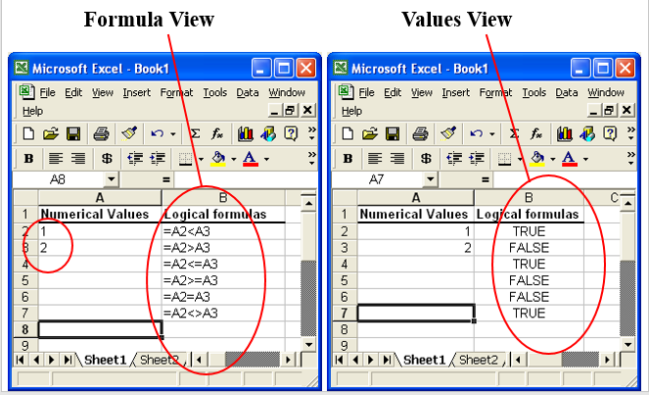
Logical Formulas

Slide 19
IF Function
The IF function is one of the most popular functions in Excel, and it allows you to make logical comparisons between a value and what you expect.
In its simplest form, the IF function says:
  IF(Something is True, then do something, otherwise do something else)

Slide 20
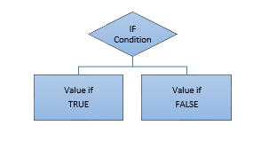
It’ll be easy for you to understand below flow chart to see how the IF functions behaves.
  =IF (logical test, value if true, value if false)

Slide 21
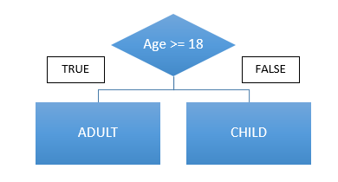
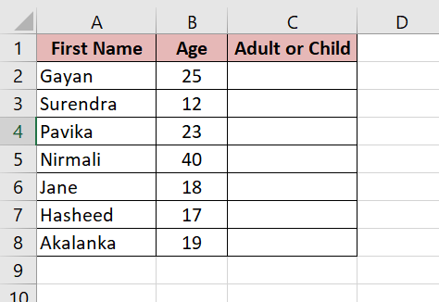
Example

Slide 22
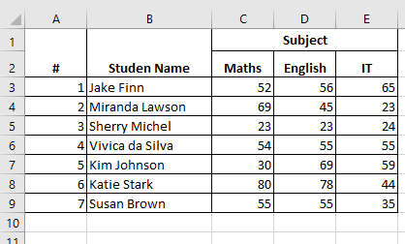
Activity 3 -
Fill the following table according to the given information
Display the total marks received by each student in column F.
Display the average marks of each student in column G.
Display the highest marks obtained for Maths in C10.
Display the lowest marks obtained for IT in E11.
Using a suitable function, display the number of students sat for English exam in D12.
Students must get average of 50 marks or more in order to progress to the next level. Display the status of each student in column H.

Slide 23
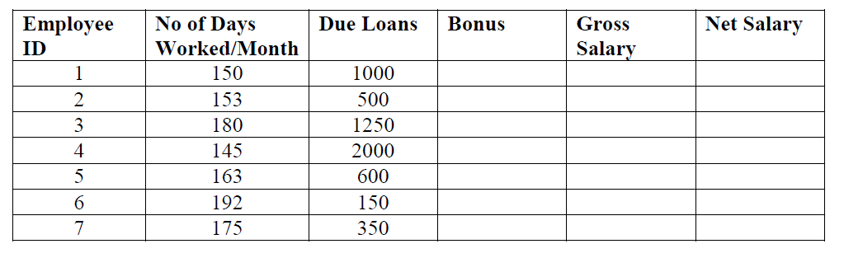
Activity 4 – IF function
Fill the following Database using the information provided.
No of hours worked/month

Slide 24
Note:
  Rate per hour is RS.275/-
  Bonus = Gross Salary
  Gross Salary = (No of hours worked/month * Hourly Rate)
  Net Salary = Gross Salary + Bonus – Due Loans
Find all the employees, whose Net Salary is greater than RS. 83,500/- and calculate payee tax.
Payee Tax = 10% of the Gross Salary
2. Add Two more columns to the database for.
      Payee Tax
      Remaining Salary
Remaining Salary = Net Salary – Payee Tax

